Slide 1


Welcome to New Student Orientation

Slide 2
Tips for College Success
Go to class!
Buy your textbooks.
Carefully read and follow the syllabus.
Use the instructor’s office hours.
Learn where and when you learn best for each kind of learning you have to do. Hawk Tour?
Make the best use of HFC’s free learning support resources. Identify your needs and prepare questions.
Learn from others, but do honest work.
Think positively and constructively.

Slide 3
Academic Integrity
HFC considers academic dishonesty to be a serious offense. Academic dishonesty is any activity intended to improve a student’s grade fraudulently.*
It includes, but is not limited to, the following:
Open cheating on an examination (such as copying from another student’s paper)
Permitting another person to take a test in the student’s place
Providing unauthorized assistance with any work for which academic credit is received
Plagiarism (using another person’s work without acknowledgment)
Bottom line: Just don’t cheat – do honest work!

Slide 4
Student Code of Conduct
See your packet!
Students at HFC are expected to show respect for order, law, the personal rights of others, and the educational mission of the College, as well as to maintain standards of personal integrity.
Includes: disrupting class, computer abuse, failure to comply with directions, etc.

Slide 5
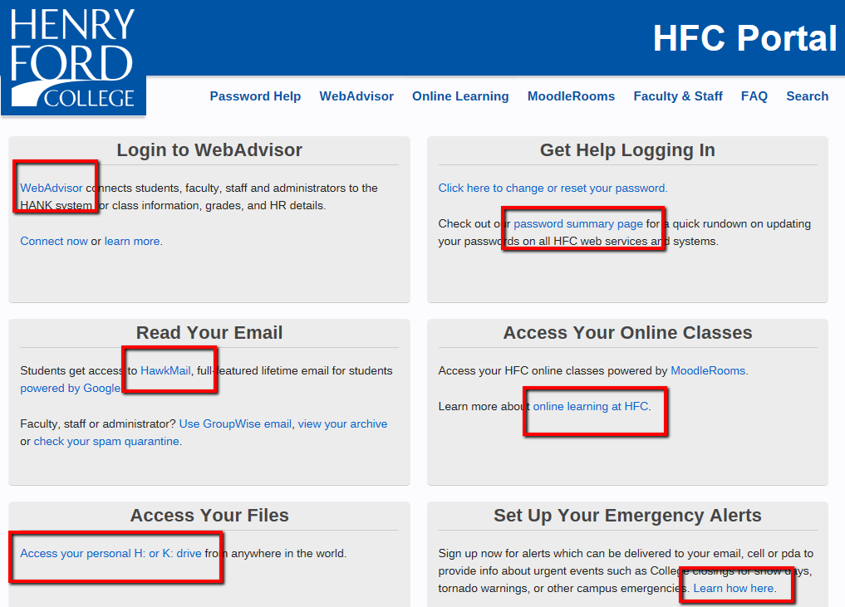
my.hfcc.edu

Slide 6
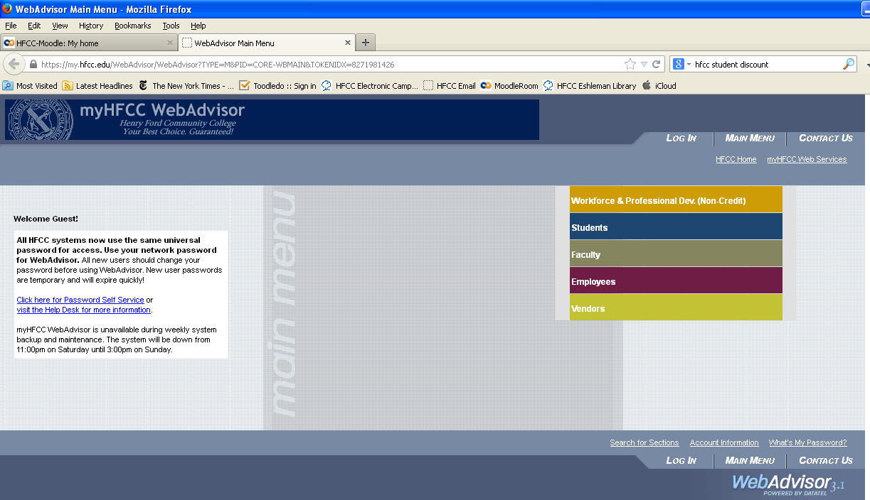
my.hfcc.edu/webadvisor
User ID/Password Help

Slide 7
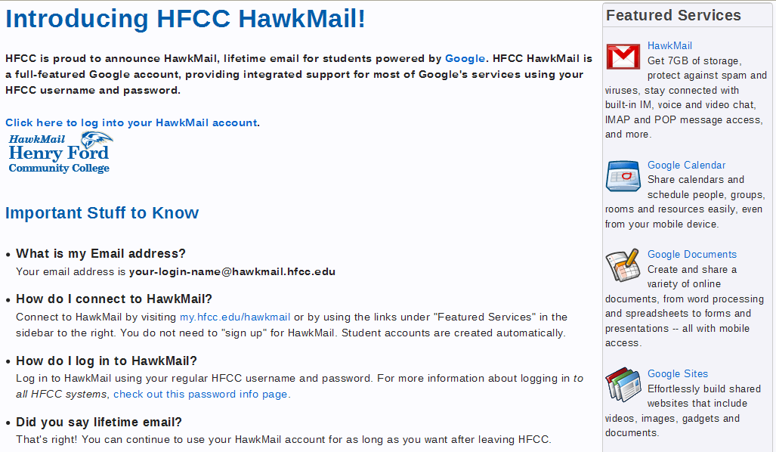
http://my.hfcc.edu/hawkmail

Slide 8
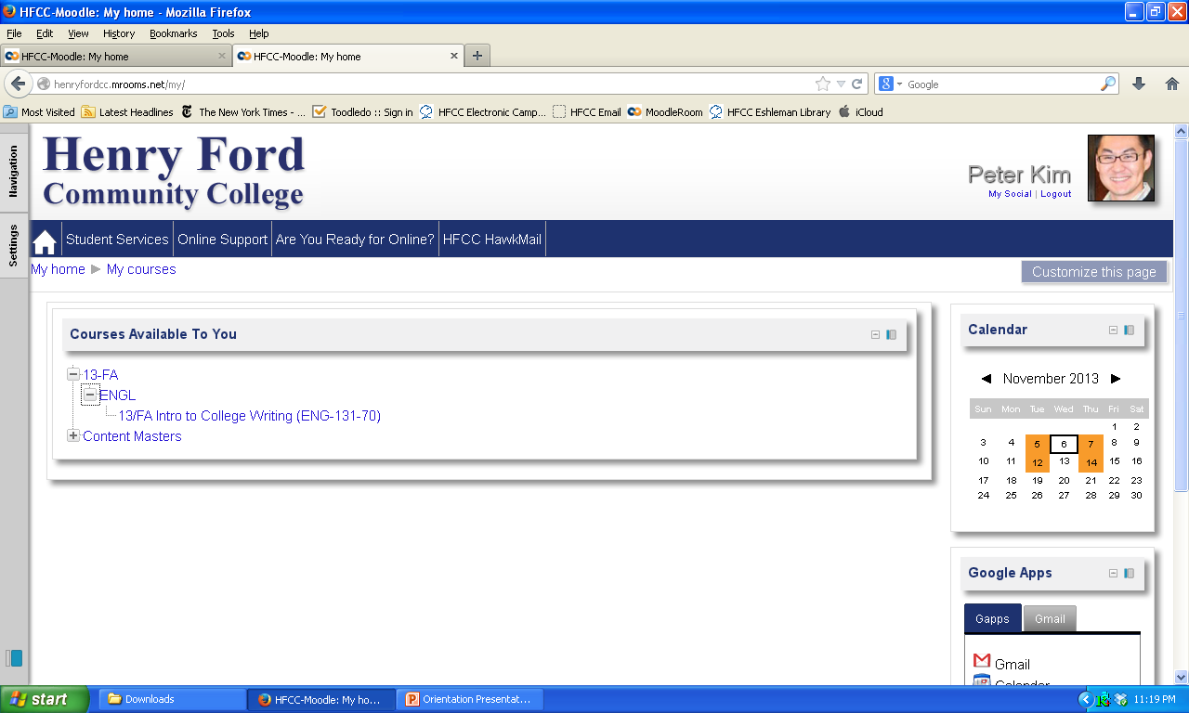
Online Learning
Notes:
Two websites: Online Learning website (first link) & Moodlerooms (second link)

Slide 9

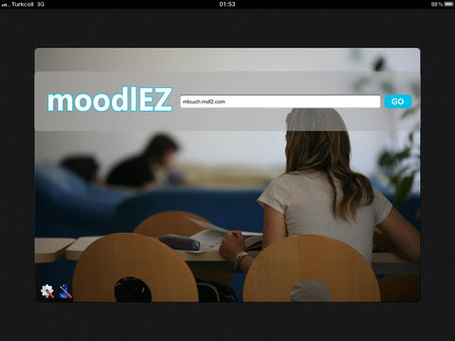
Become familiar with the College’s Mobile Apps
Download MoodleEZ to your iPad.
Type the URL: http://henryfordcc.mrooms.net
Login using your WebAdvisor username and password.
http://henryfordcc.mrooms.net
Download EllucianGo to your Android or iPhone Device.
Search for “Henry Ford College”
Login using your WebAdvisor login.
Type: http://henryfordcc.mrooms.net

Slide 10
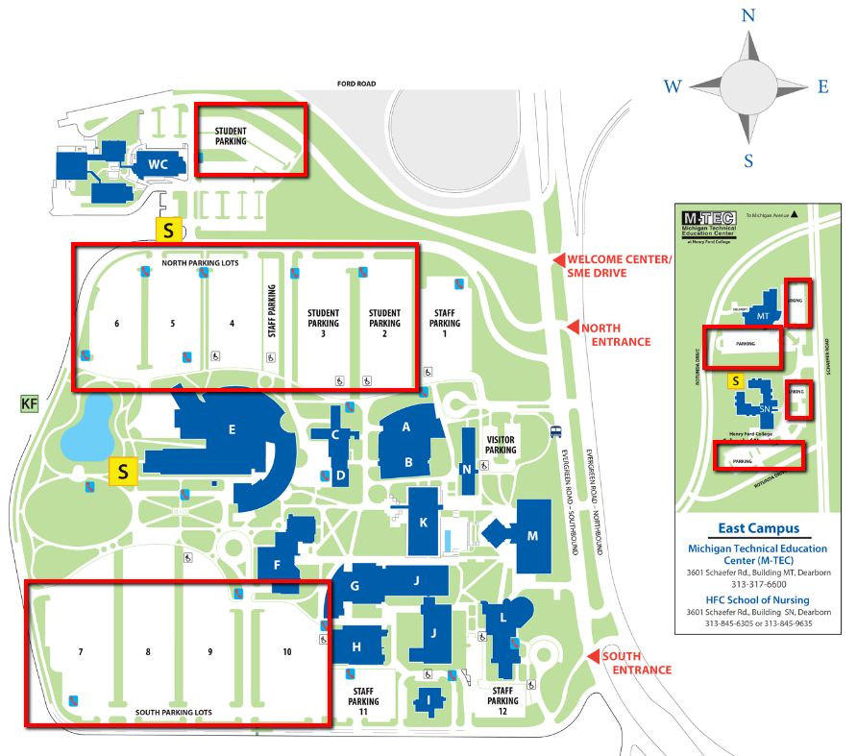
We are here!
Parking:
2800
FREE
Parking
spaces
East Campus:
MTEC
and Nursing Buildings

Slide 11
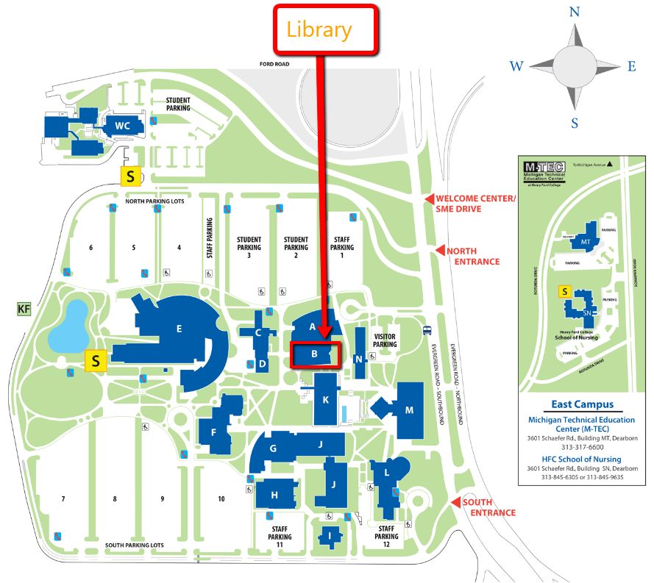
Media Center:
free computer access
Printing
Helpful
librarians
and
staff
Free
online
Research
Databases
Books

Slide 12
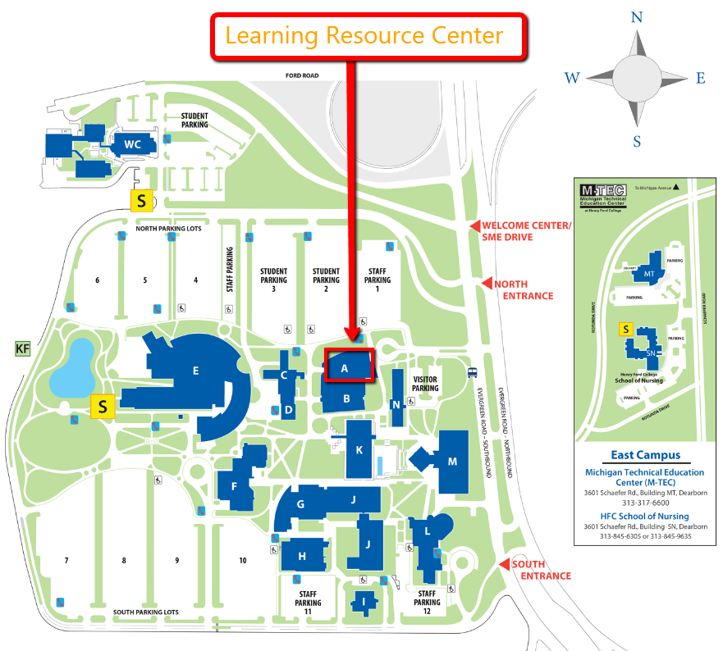
Come find us!
Counseling
Career Services
Learning Lab:
Free
Tutoring
Test Preparation
Notes:
Point out the speed trap between Cherry Hill and Ford Rd. HFCC and U of M Dearborn students get tickets daily.

Slide 13
Student Services

Slide 14
Academic Advising https://www.hfcc.edu/academic-advising
Program Planning
Study Plan
Course Selection
Program Evaluation
Graduation Requirements

Slide 15
College Transfer Advising https://www.hfcc.edu/counseling
Program Planning
Course Equivalencies
Curriculum Guides
Articulation/Transfer Agreements

Slide 16
Counseling Services
www.hfcc.edu/counseling
Career Guidance & Counseling
Interest Inventories
Personal & Career Development Courses
Time Management
Stress Management
Test Anxiety
Goal Setting
Work Challenges

Slide 17
Assisted Learning Services
www.hfcc.edu/als
Quiet testing rooms
Note takers
Readers
Writers for tests
Interpreters for the hearing impaired
Adaptive Lab

Slide 18
Student Outreach and Support
www.hfcc.edu/sos
Personal Counseling
Academic Training
Financial Assistance
    Dreamkeepers
    Emergency Fund
Notes:
I’ve noticed that the best students seem to ask a LOT of questions! They are polite and friendly, and they ARE persistent! I THINK DOING WELL REQUIRES GETTING THE ANSWERS YOU NEED.
In class, if YOU have a question, you can bet others do too!
In my office I’m GRATEFUL for your questions. SOME information I repeat many times a day and SOMETIMES I leave out part of it, sometimes I say it too fast, sometimes I think you already know. Thank you for asking US questions— we really WANT to be helpful! TY FOR BEING PATIENT,TOO!
AND if you don’t know WHERE to get an answer, ask us! FOW doesn’t require appointments. If we don’t KNOW the answer to your question, we can find the answer TOGETHER.
I’m a BIG believer in the ‘BUDDY system’. Buddies encourage each other; study together, remind each other of things to be done. Find a BUDDY in your classes – someone to take notes if you are ill and someone for YOU to help, if necessary. It works!
…And if you need a Buddy here, let FOW be your FIRST Buddy at HFCC.

Slide 19
Office of Career Services
http://careers.hfcc.edu
Cover Letter Writing
Resume Writing
Dress for Success
Workplace Transition
Job Search Strategies
On-campus Job Fairs

Slide 20

Student Activities
www.hfcc.edu/sa
40 Registered Student Groups
Leadership Skills
Fun Campus Activities
Student Council
Community Service

Slide 21

Men’s Teams | Women’s Teams | Co-ed
Baseball Basketball | Basketball Softball | Golf
http://athletics.hfcc.edu
Club Sports
  Compete with Club teams at other colleges/universities
  Wrestling Club began in 2013
  Clubs such as soccer and tennis will be added based on student interest.
Fitness Gym
  Free exercise equipment and free weights

Slide 22

Student ID Cards
Safe Walk
Vehicle Jump Starts
Lost and Found
Sign up for Emergency Alert
https://www.mir3.com/hfcc/

Slide 23
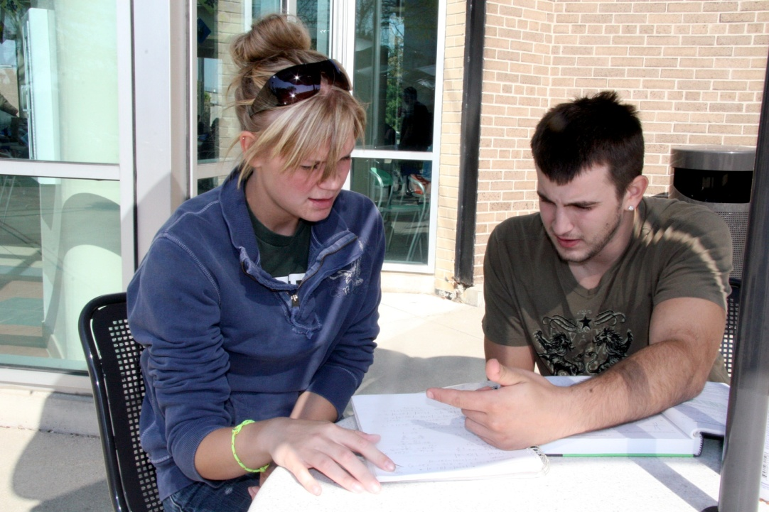
Inside Track Peer Mentors https://www.hfcc.edu/inside-track
Peer Mentors give first year students the “inside track” in being successful.
One-on-one assistance with registration, financial aid, and other student concerns.
Mentees enjoy seminars and workshops focused on improving their chances of success.

Slide 24
Cashiers Office https://www.hfcc.edu/tuition-and-payment
Tuition Calculator
EZ-Pay
Master Promissory Note
WebAdvisor
Higher One
Important Dates
Questions?

Slide 25
Welcome Center
https://www.hfcc.edu/student-services/welcome-center
The Admissions, Records, Registration Financial Aid, Cashiers, Assessment, International Admissions, and Academic Advising departments are located in the HFC Welcome Center.
Hours:
Monday – Thursday 8:00 a.m. – 6:30 p.m.
Friday 8:00 a.m. – 4:30 p.m.

Slide 26
Welcome Center
https://www.hfcc.edu/student-services/welcome-center
CONCIERGE – Our Concierge will greet you and direct you as you enter the Welcome Center.
CAMPUS SAFETY – With a copy of your class schedule, you can have your Student ID card made immediately.
COMPUTER LAB: THIS IS YOUR STARTING POINT!
Admissions- Apply to HFC
Apply for Financial Aid (FAFSA)
Review your student records
Request transcripts
Register for classes
Review financial aid status
HawkMail
WebAdvisor access

Slide 27
Welcome Center
https://www.hfcc.edu/student-services/welcome-center
CASHIERS OFFICE – Billing & payment, account questions.
SOLUTION CENTER – With referral from Computer Lab, assistance to resolve more difficult issues.
ASSESSMENT OFFICE – COMPASS Course Placement administered. Appointments are not required … must have picture ID.
ACADEMIC ADVISING – Receive assistance in selecting a career path, & course planning for your educational goals. No appointment necessary.
VETERANS CERTIFICATION – Assistance to identify & activate VA educational benefits for which you are eligible.

Slide 28
Please stay seated
and we will help guide you to your next step.

Slide 29
COMPASS
Placement Exam
Overview, practice, recommendations

Slide 30
Questions …
What is the COMPASS Placement Exam?
  Multiple Choice
  3 parts:
    1) Math 2) Reading 3) Writing
What is it for?
  Class placement – the right class.
  Challenging, but chance at success.

Slide 31
Questions …
Why is it important?
  Saves time
  Saves $
  Other college courses
Who should take it?
  Low ACT scores
  Not satisfied with math placement

Slide 32
COMPASS Facts…
  You many not need all 3 parts.
  Not timed: ~30-45 minutes/test
  Retake or Placement
  It’s adaptive – depends on you!

Slide 33
COMPASS Math
Algebra
PreAlgebra
Intermediate
Beginning
Beginning
Intermediate

Slide 34
Math Score Interpretation
Test | Score | Class
PreAlgebra | < 39 | Math 074/077
 | 39+ | Math 080/081/100
Algebra | < 46 | Math 080/081/100
 | 46-65 | Math 110/131
 | 66+ | Math 112/115/121/141/150
College Algebra | < 51 | Math 112/115/121/141/150
 | 51+ | Math 153/175
Trigonometry | < 51 | Math 175
 | 51+ | Math 180

Slide 35

Calculators!
USE THEM!!! Don’t let the “easier” questions hold you back!

Slide 36
What does the Math test look like?

Slide 37
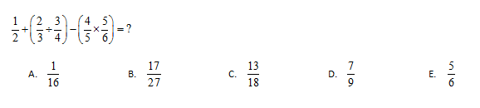
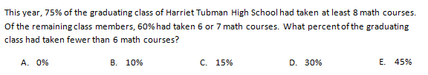
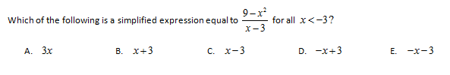
How would you do the following …

Slide 38
And the answers are …

Slide 39
And the answers are …

Slide 40
Before taking the COMPASS Math:
Practice:
  At home: http://learnlab.hfcc.edu/placement
  Free Tutoring: Learning Lab
Topics:
  Like Math: Algebra and higher
  Hate Math: PreAlgebra and Algebra

Slide 41
English Placement Exams
Reading & Writing

Slide 42
English Score Interpretation
English | WS 0-22 | WS 23-77 | WS 78-100
RS 0-24 | Non Placement | Non Placement | Non Placement
RS 25-50 | 079/088 | 079 | 081
RS 51-81 | 081/088 | 081/093 | 131
RS 82-100 | 088 | 093 | 131
ENG 079: Basic Reading
ENG 081: Developmental College Reading
ENG 088: Basic Writing: Sentences to Paragraphs
ENG 093: Basic Writing: Paragraphs to Essays
ENG 131: Introduction to College Writing
ENG 132: College Writing and Research

Slide 43
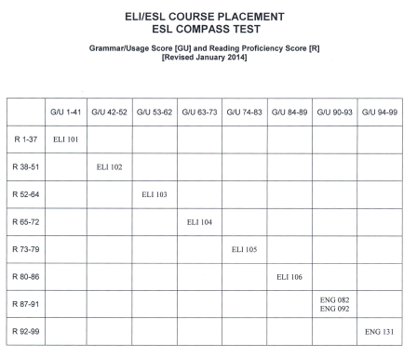
English Score Interpretation

Slide 44

What does the reading test look like?

Slide 45
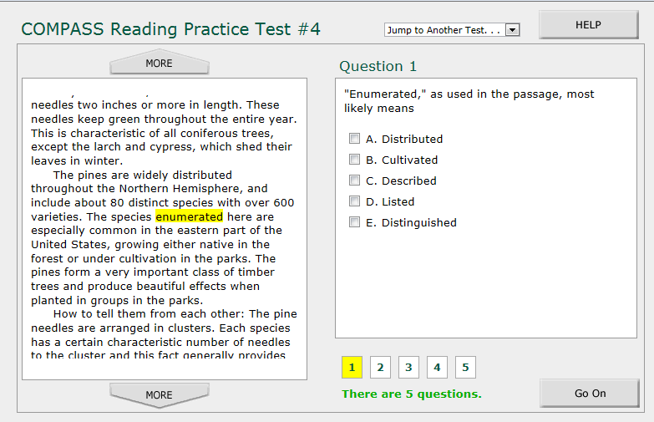
What does the reading test look like?

Slide 46
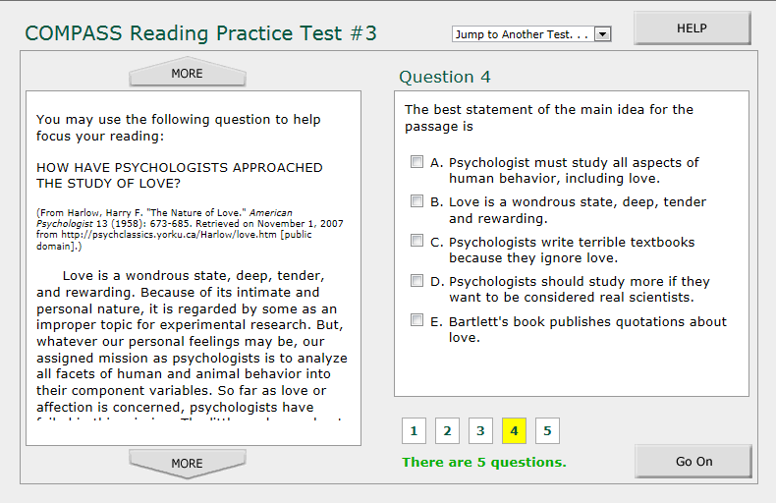
What does the reading test look like?

Slide 47
And the answers are …

Slide 48
And the answers are …

Slide 49
And the answers are …

Slide 50

What does the writing test look like?

Slide 51
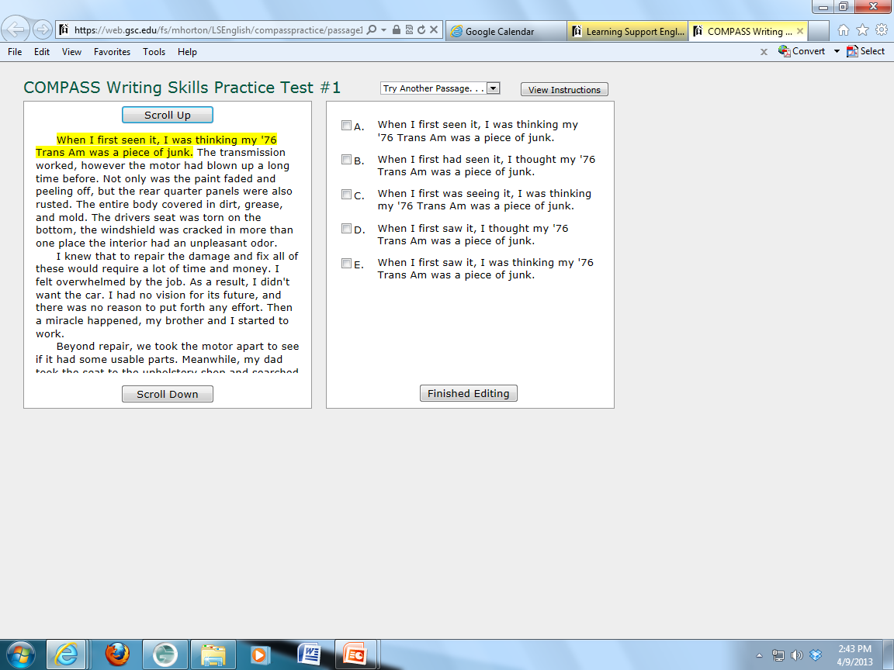
What does the writing test look like?

Slide 52
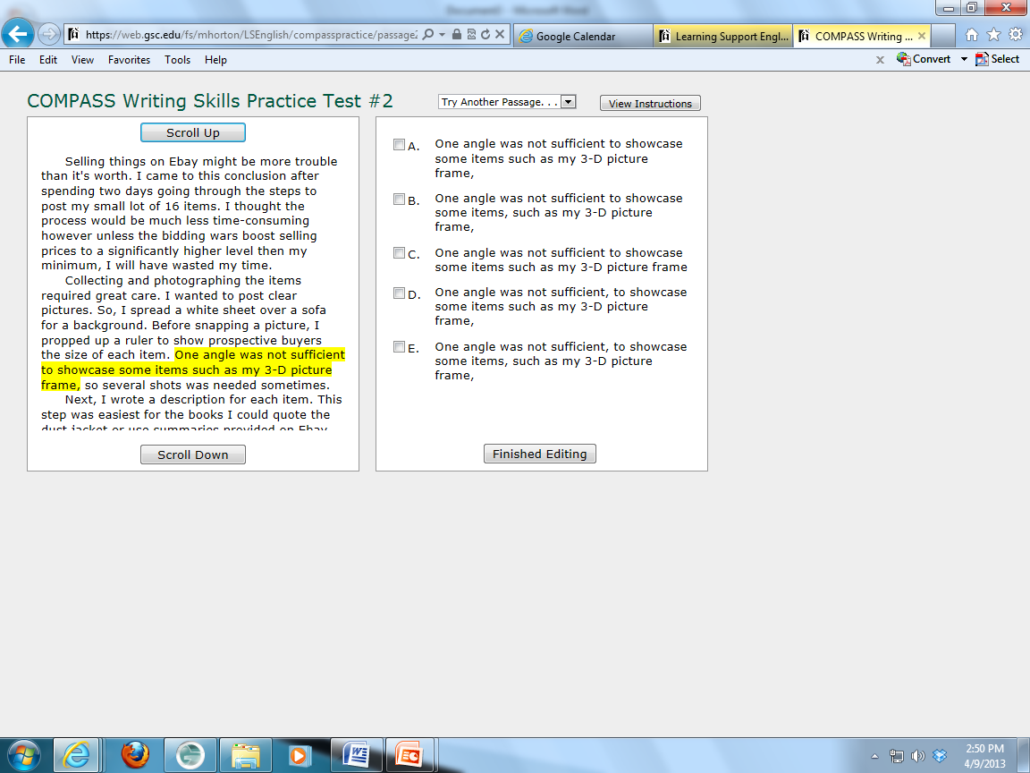
What does the writing test look like?

Slide 53
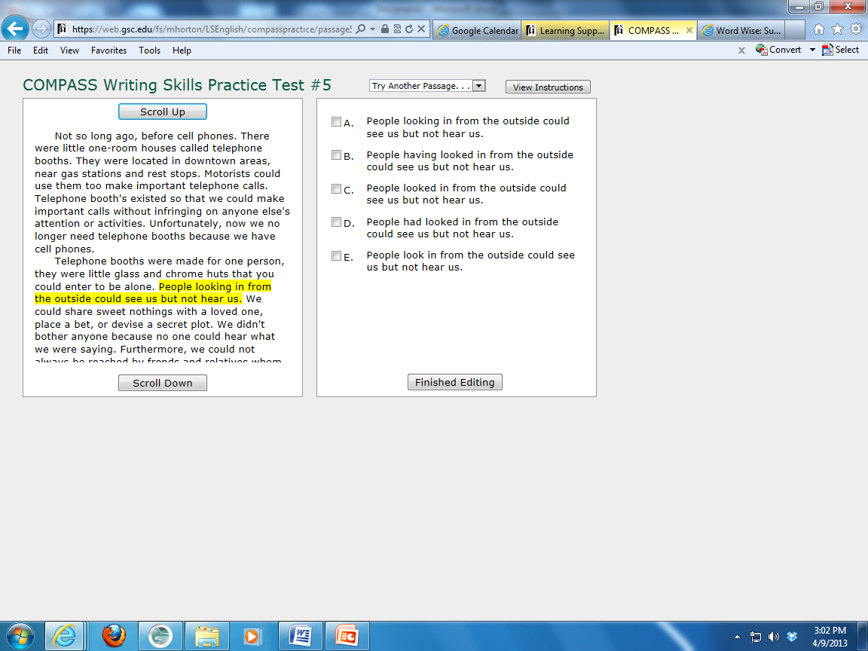
What does the writing test look like?

Slide 54
And the answers are …

Slide 55
What does the writing test look like?
The highlighted sentence has two verb tense errors. The two verb tenses should be parallel, or the same tense.

Slide 56
What does the writing test look like?
The rule here is to use a comma with the phrase “such as.”

Slide 57
What does the writing test look like?
If there is nothing wrong with the highlighted part, then the answer will always be “A.”

Slide 58
COMPASS Preparation Workshops
Learning Lab, 2nd Floor, LRC Building
To Register call: 313-845-9765 or Email: LLabTesting@hfcc.edu
ENGLISH Workshops
Wednesday | Nov 19 | 11:00 am – 12:30 pm
Tuesday | Dec 2 | 1:00 pm – 2:30 pm
Monday | Dec 8 | 11:00 am – 12:30 pm
MATH Workshops
Tuesday | Nov 18 | 2:00 pm – 3:30 pm
Thursday | Nov 20 | 2:00 pm – 3:30 pm
Monday | Dec 8 | 5:00 pm – 6:30 pm
Drop-ins Welcome anytime between 8am – 6:30pm, Mondays - Thursdays
For more resources, visit: http://learnlab.hfcc.edu/placement

