Slide 1

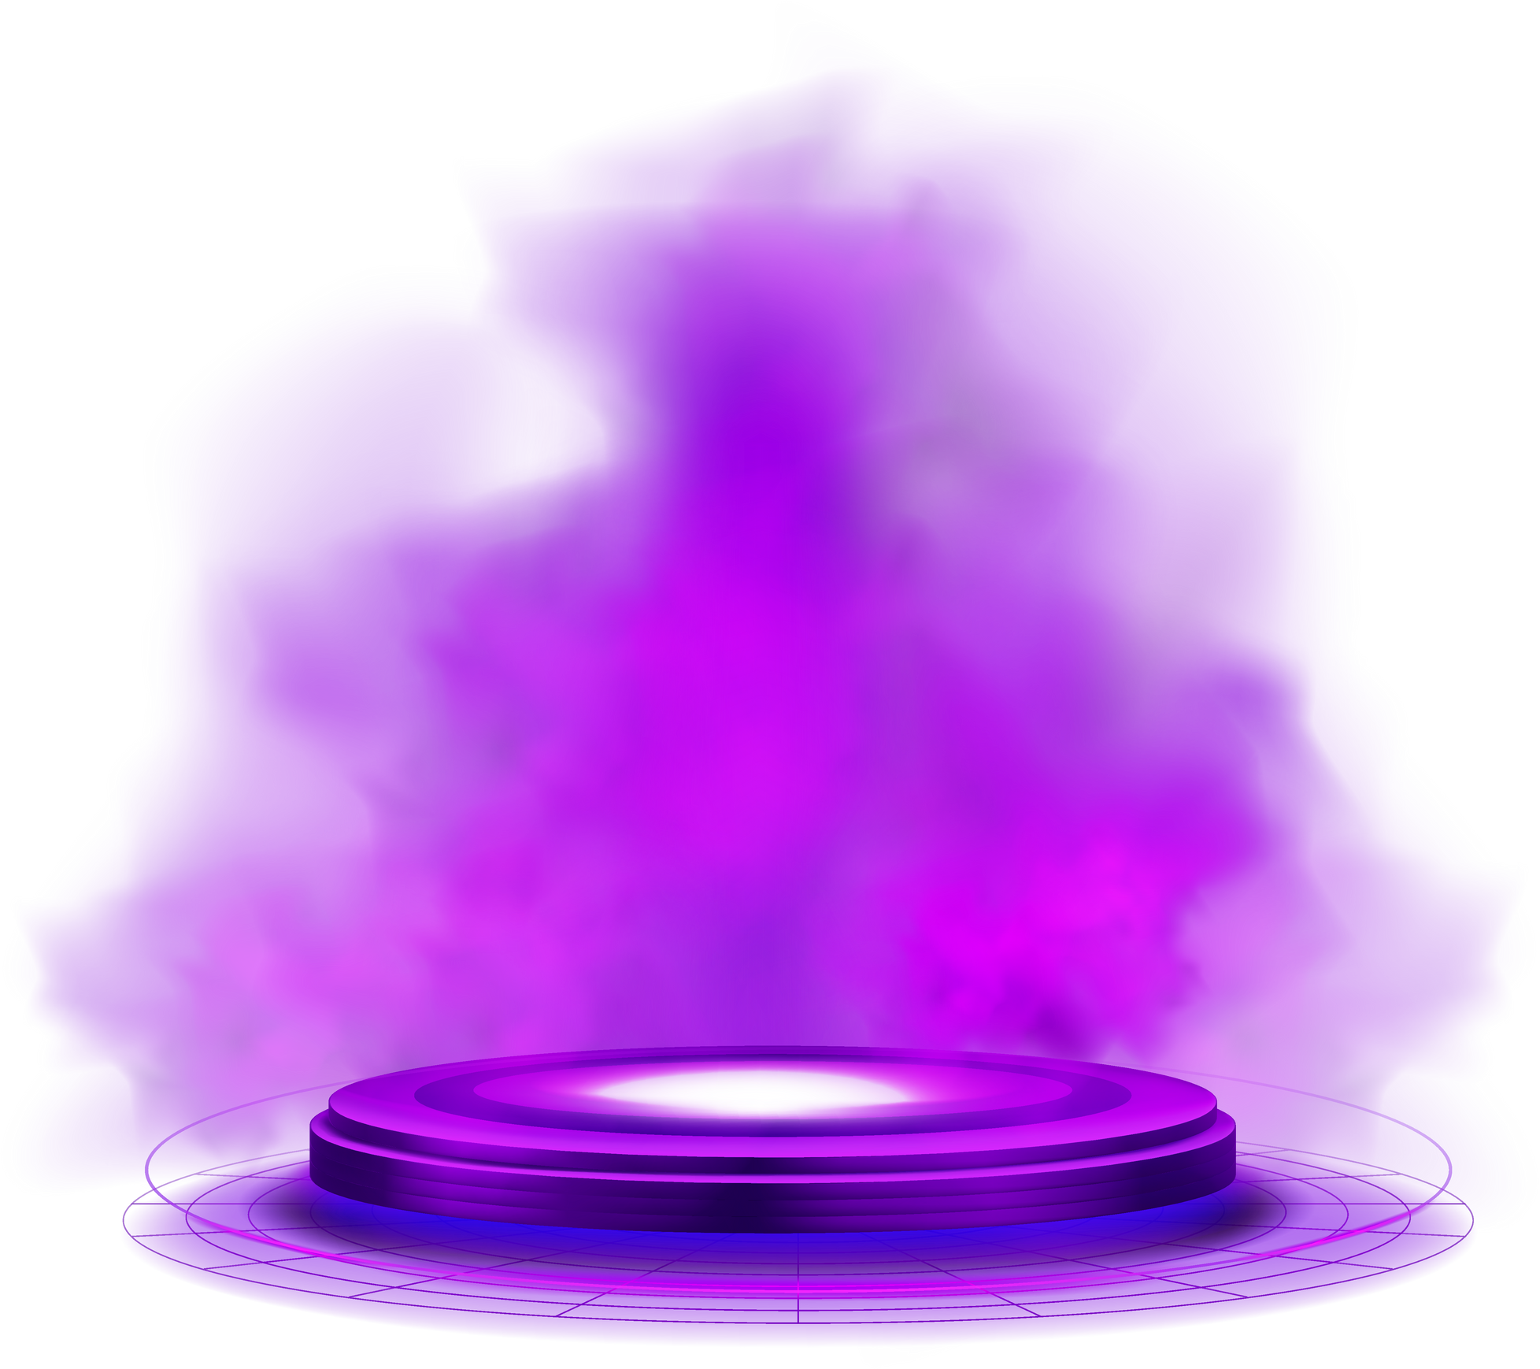
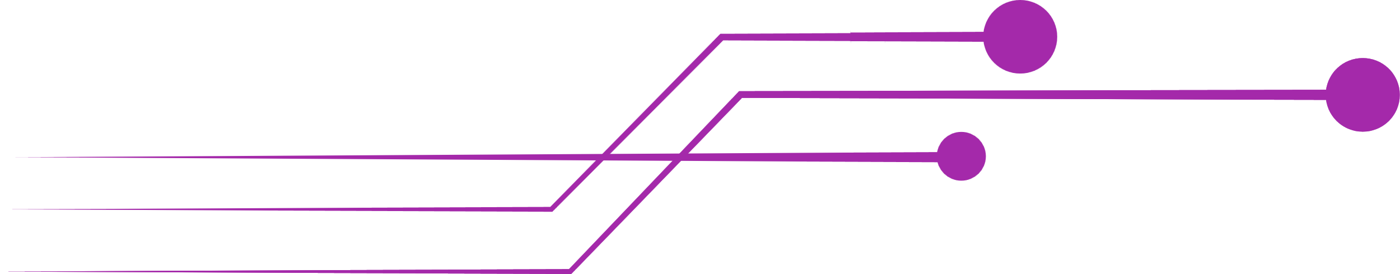
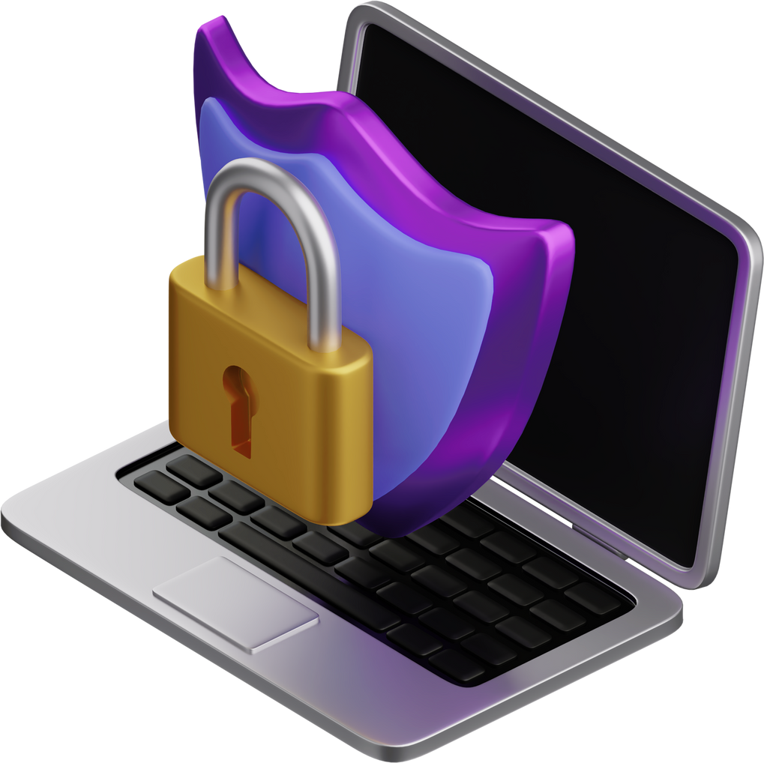
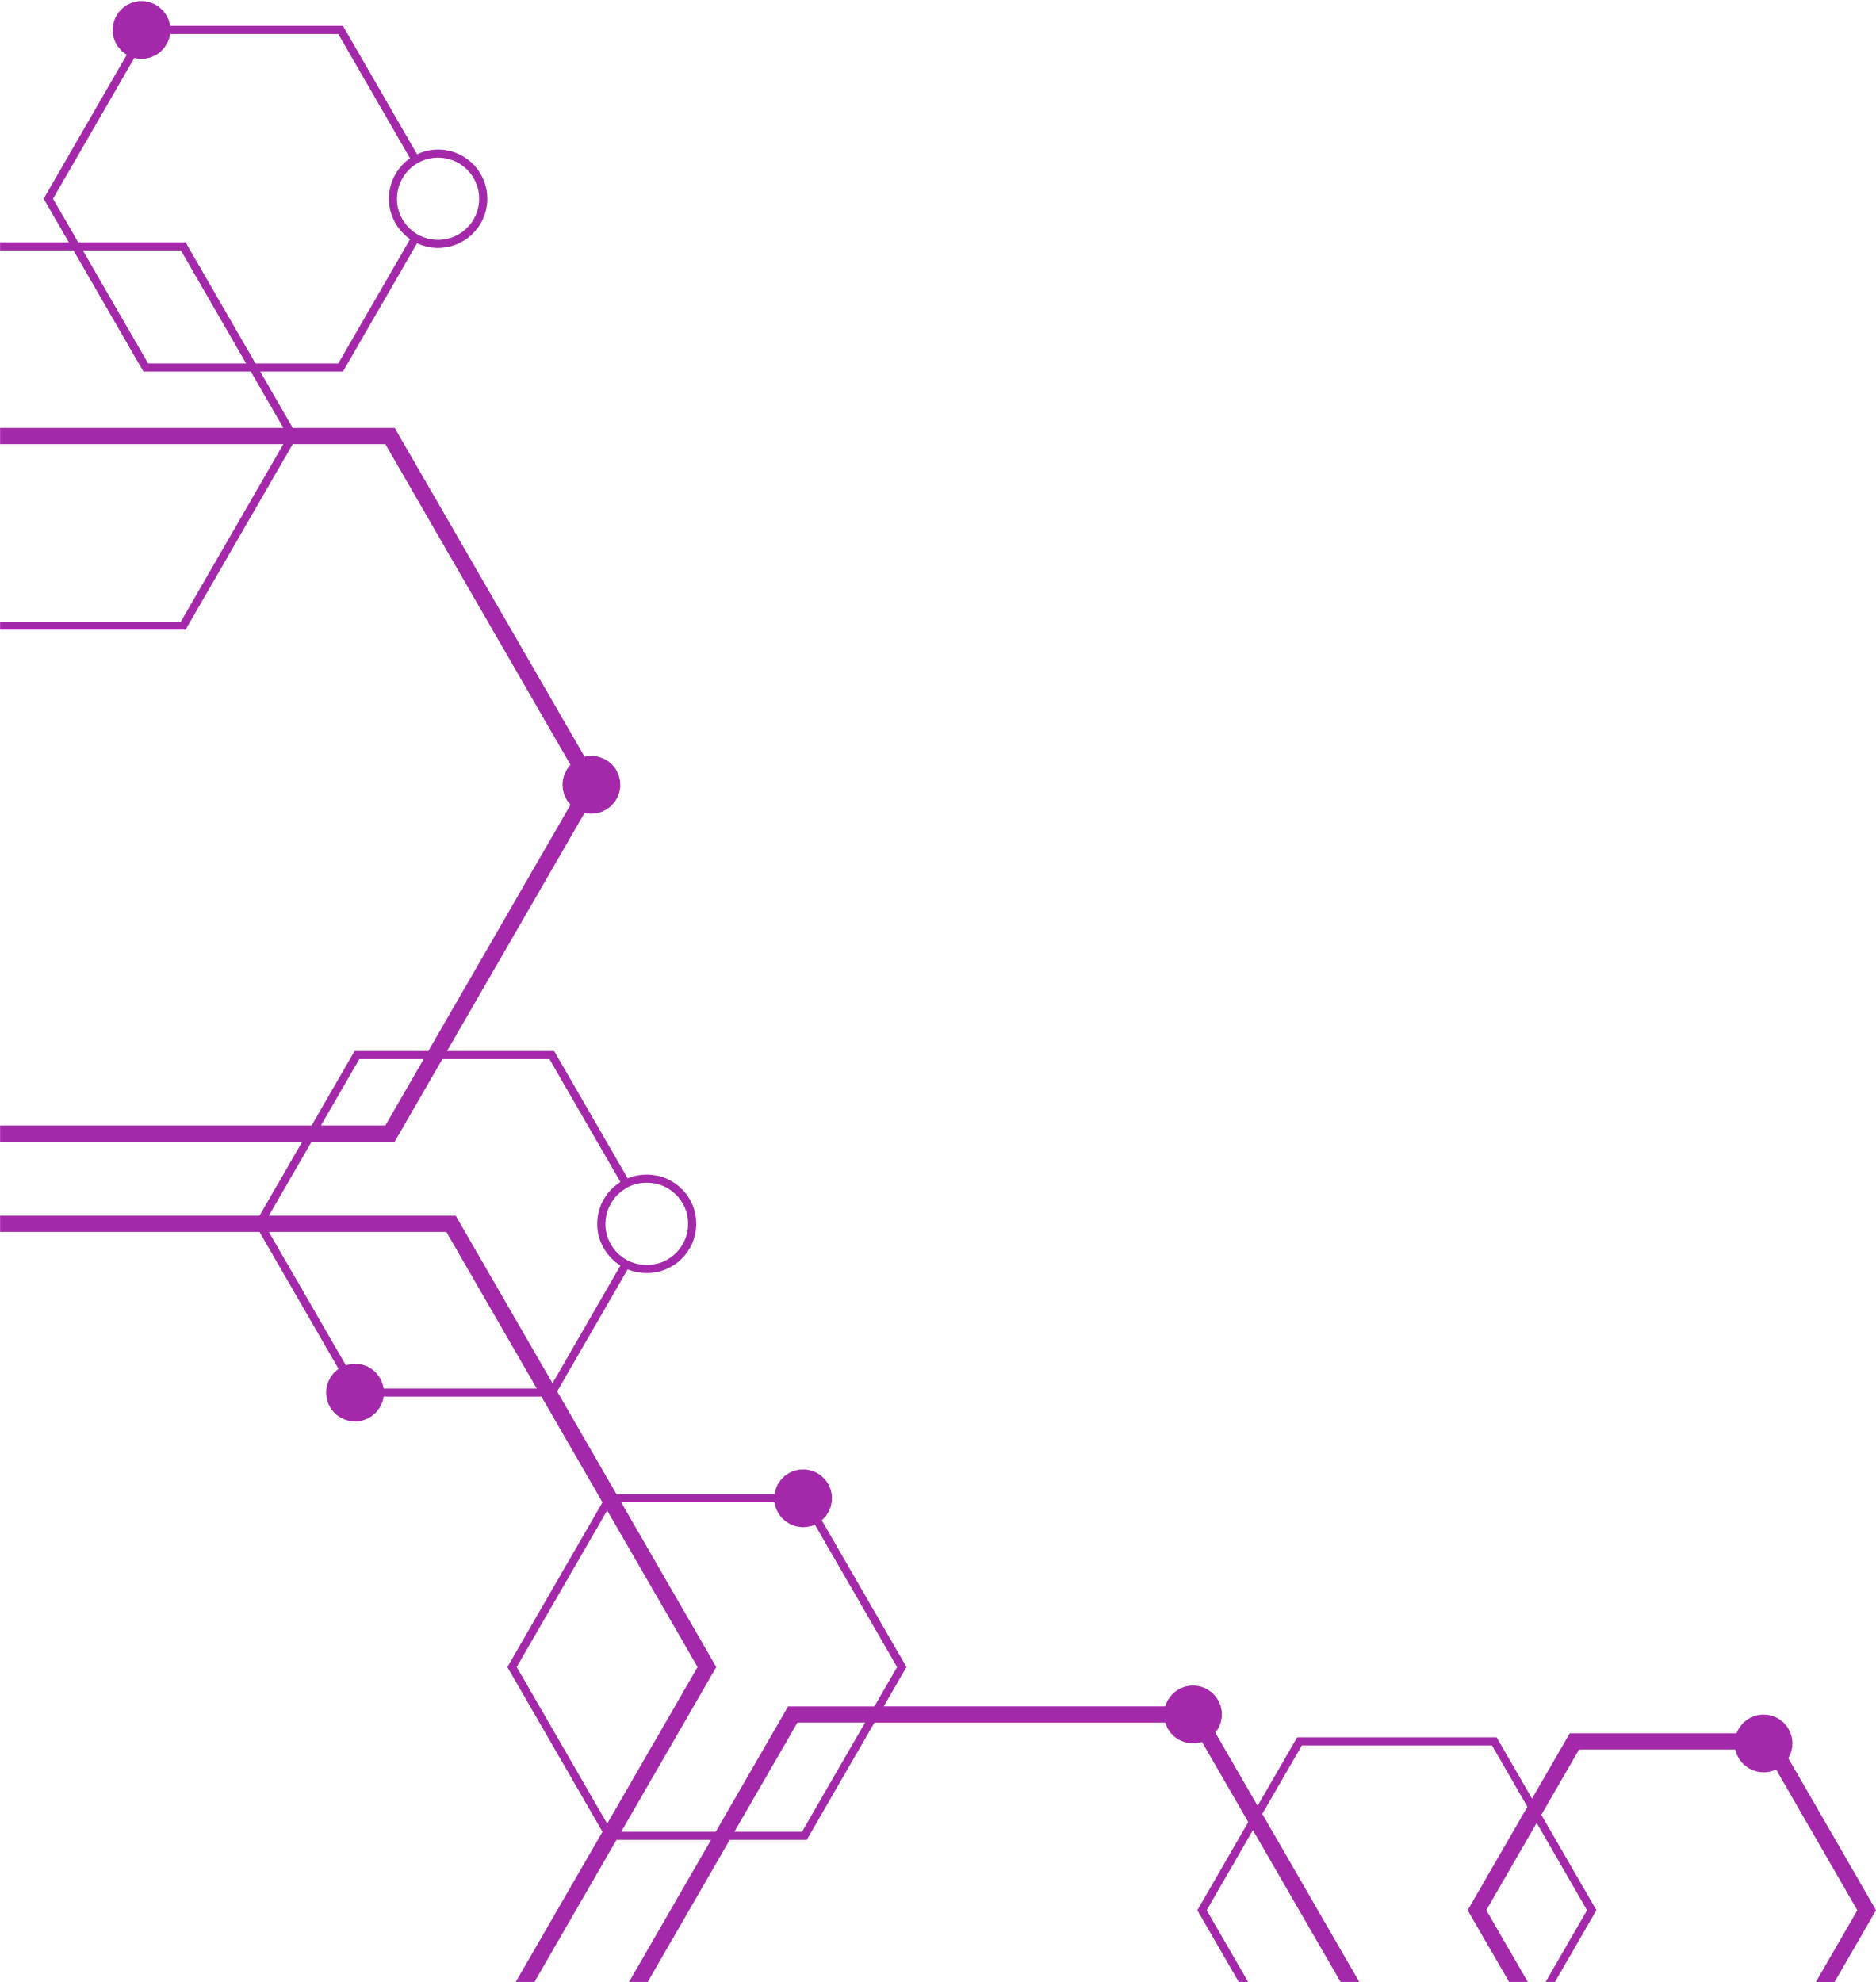
THE AVENGERS
INCIDENT
RESPONSE
PLAN (IRP)
STAY AHEAD OF THREATS, STAY SECURE.

Slide 2


THE
AVENGERS
SCENARIO 1
RANSOMWARE ATTACK VIA COBALT STRIKE BEACON

Slide 3
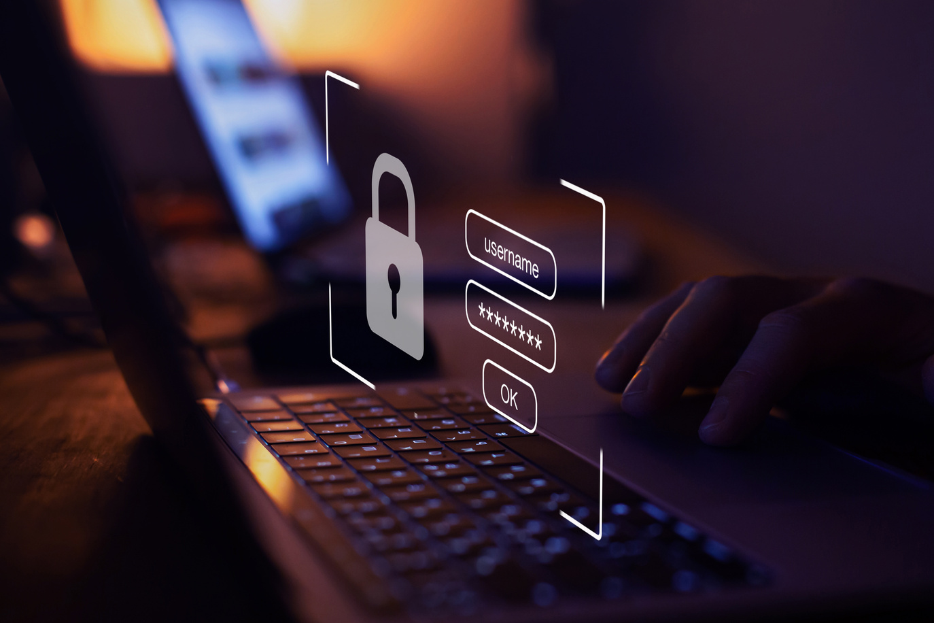
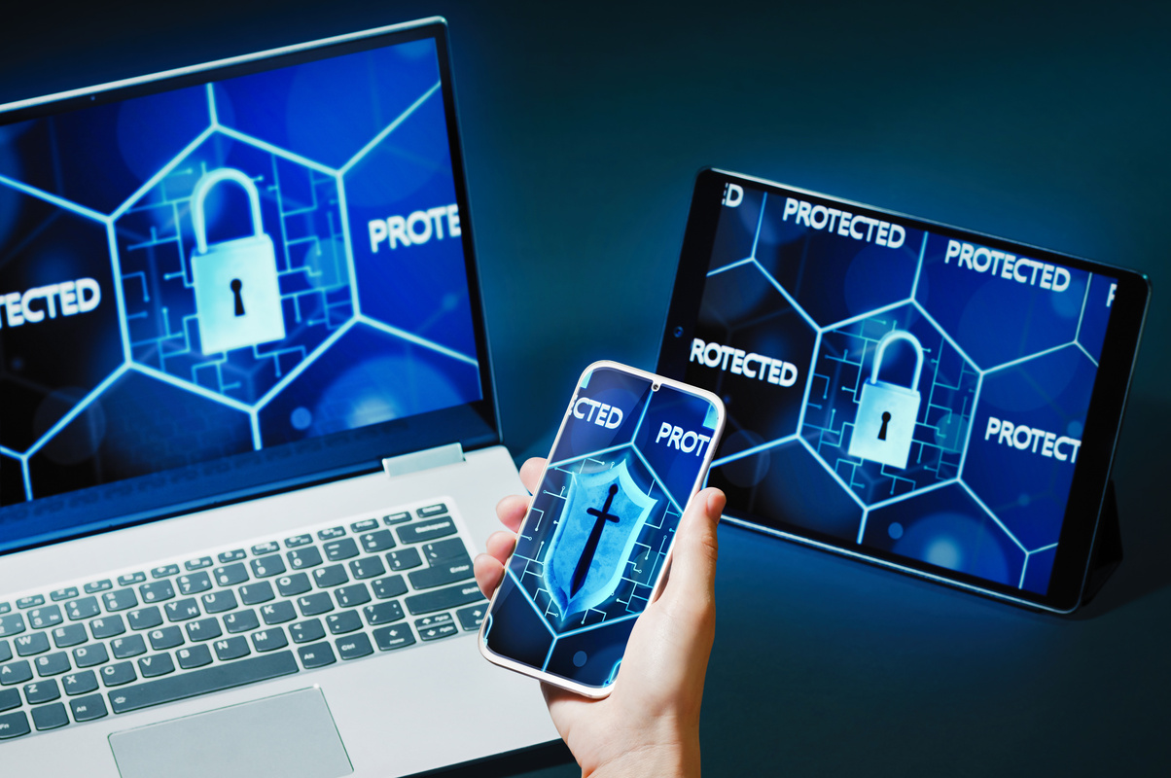
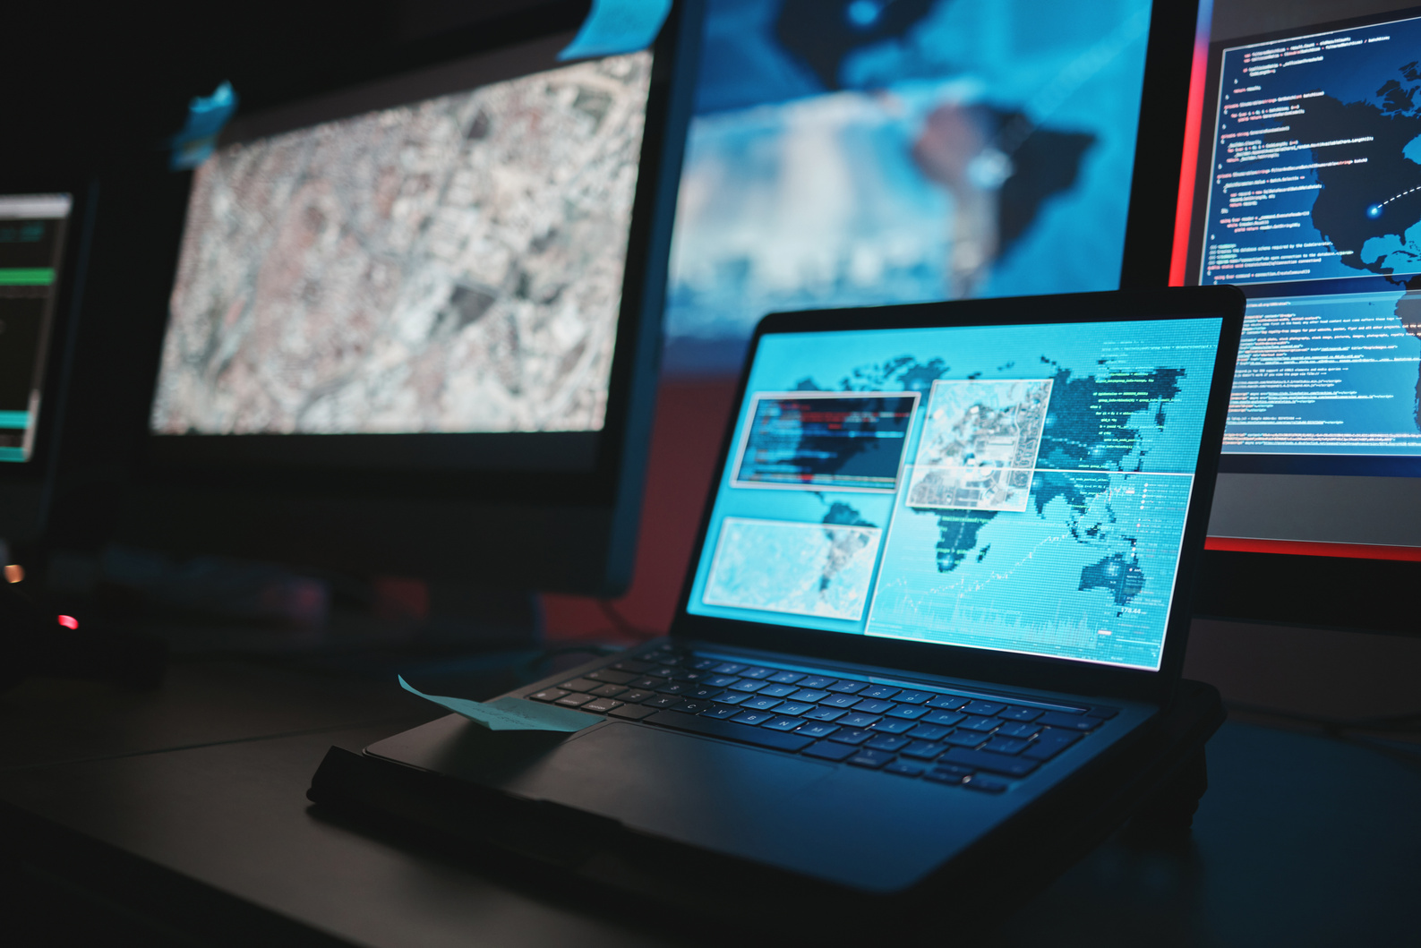
THE
AVENGERS
INCIDENT
TIMELINE
9:22 AM
10:15 AM
11:32 AM
Palo Alto firewall alerts on Cobalt Strike Beacon traffic to a suspicious Google-hosted domain.
User reports file access issues and network slowdowns.
Confirmed ransomware spreading via an unknown Windows exploit.

Slide 4
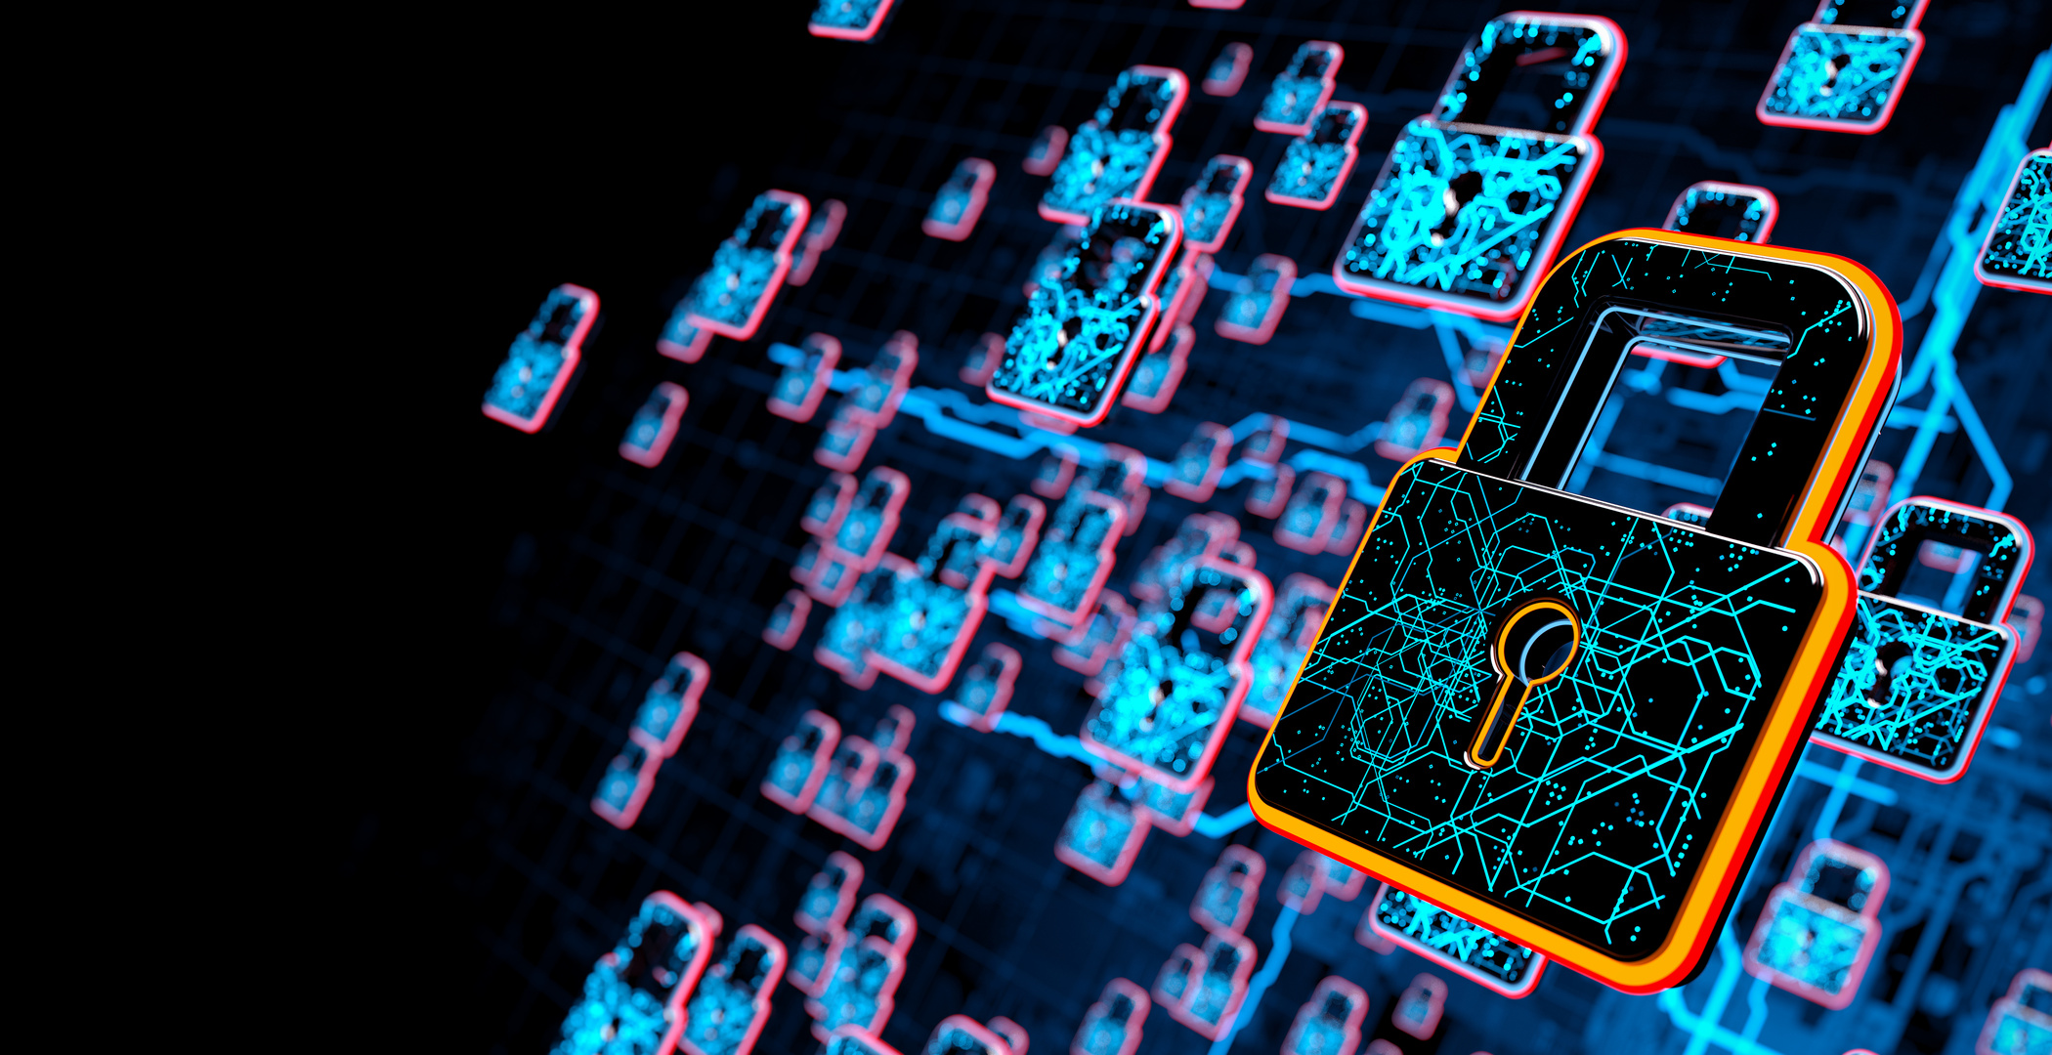

THE
AVENGERS
KEY
OBSERVATIONS
Initial Missed Signs
csc.exe (a legitimate Windows process) was hijacked to execute malicious payloads.
No prior traffic to the malicious domain in 90 days (should have triggered higher scrutiny).
Lateral Movement
Ransomware spread to adjacent systems, causing department-wide outages.

Slide 5
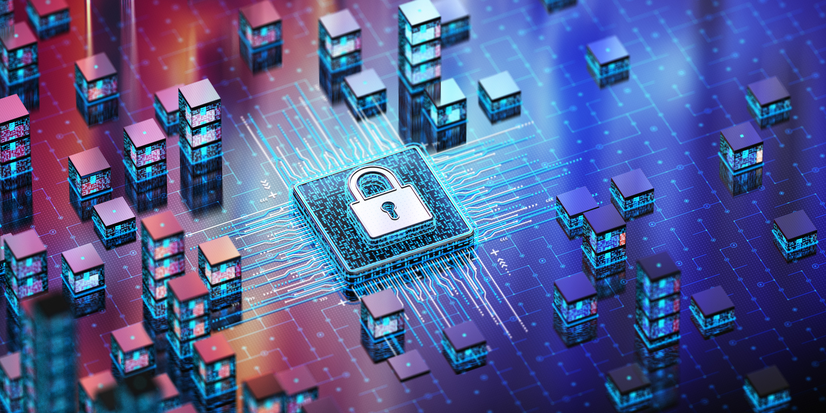
THE
AVENGERS
WHAT WENT
1. DELAYED CONTAINMENT
WRONG?
Isolating individual machines was too slow; network segmentation should have been immediate.
2. LOG ANALYSIS GAPS
No Splunk/SIEM correlation of csc.exe spawning hidden TEMP files (a known ransomware tactic).
3. COMMUNICATION BREAKDOWN
Employees weren’t notified to stop work, worsening operational impact.

Slide 6
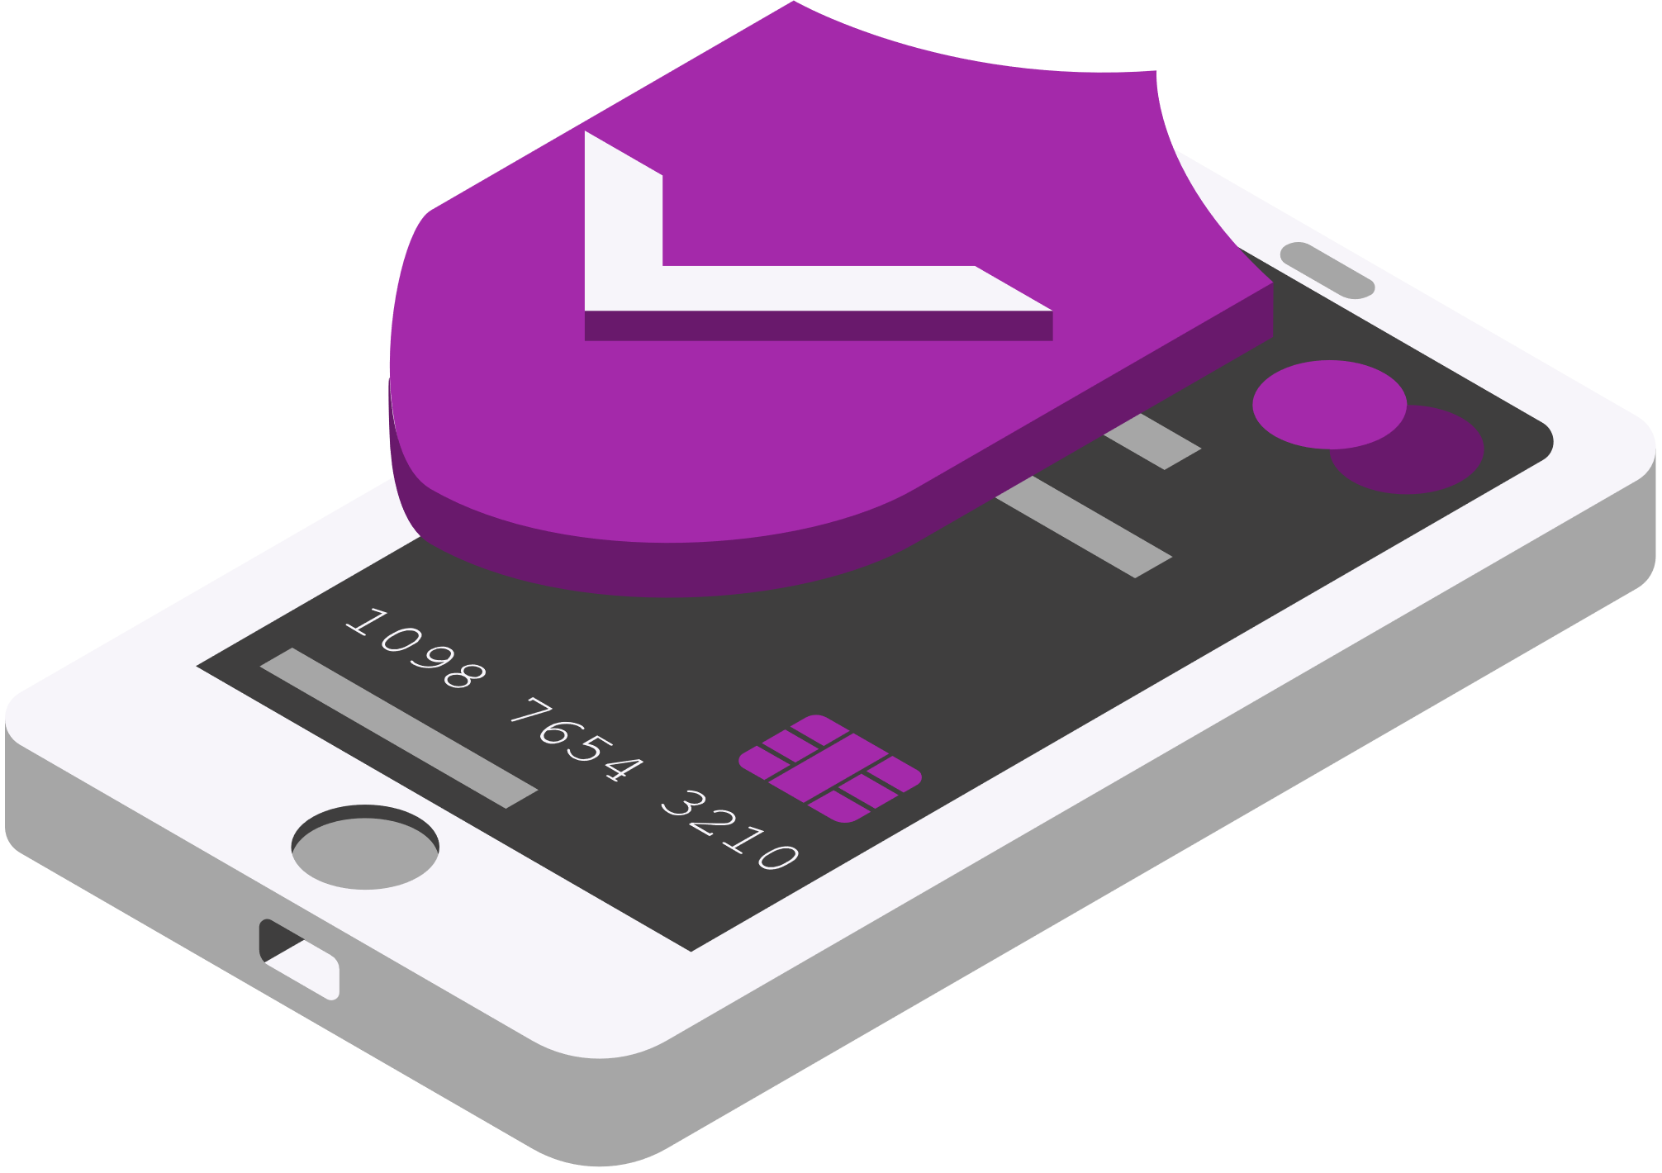
THE
AVENGERS
ACTION
PLAN
STEP TEAM RESPONSIBLE TIME FRAME
SHUT DOWN THE AFFECTED VLAN
NETWORK SECURITY
IMMEDIATE
DEPLOY EDR TO TERMINATE MALICIOUS PROCESSES
SOC ANALYSTS
1 HOUR
NOTIFY LEADERSHIP/EMPLOYEES
IT/COMMS
30 MINUTES
RESTORE FROM OFFLINE BACKUPS
DISASTER RECOVERY
4+ HOURS

Slide 7
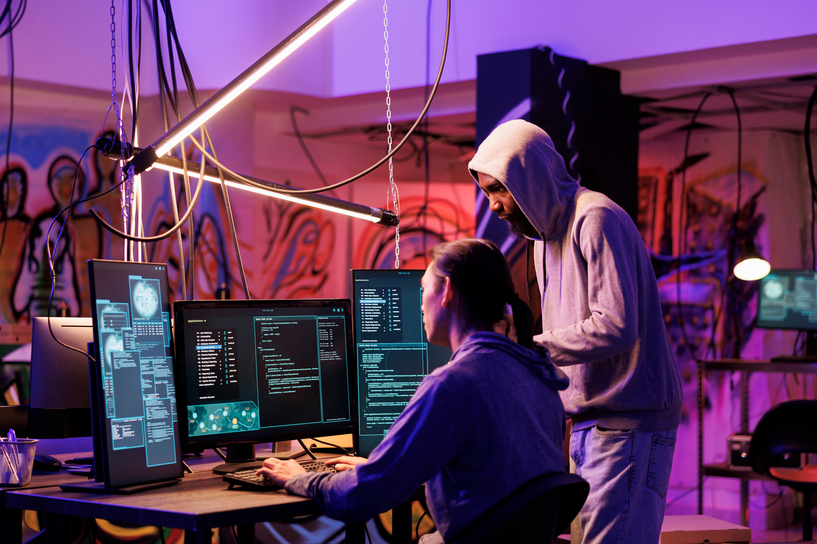

THE
AVENGERS
LESSONS
LEARNED
Automate Playbooks: Block traffic to newly registered domains (e.g., via Palo Alto WildFire).
User Training: Teach staff to report unusual system behavior (e.g., "Why is my PC slow?").

Slide 8
THE
AVENGERS
SCENARIO 2
PHISHING → MFA FATIGUE → DATA EXFILTRATION

Slide 9
THE
AVENGERS
INCIDENT
TIMELINE
11:52 AM
12:30 PM
1:15 PM
1:45 PM
Palo Alto firewall alerts on Cobalt Strike Beacon traffic to a suspicious Google-hosted domain.
User reports file access issues and network slowdowns.
Confirmed ransomware spreading via an unknown Windows exploit.
50GB data transfer attempted from the data center.

Slide 10
THE
AVENGERS
KEY
OBSERVATIONS
Phishing Lure: Fake "company newsletter" with training updates (high click rate).
MFA Exploit: Attackers spammed push notifications until the user relented.
Data Theft: The Attacker accessed sensitive data before password resets.

Slide 11
THE
AVENGERS
WHAT WENT
1. EMAIL FILTER FAILURE
WRONG?
Defender missed lookalike domains (e.g., "electricenerrgy.com" vs. "electricenergy.com").
2. NO DATA TRANSFER ALERTS
50GB transfer to an unknown IP wasn’t flagged.
3. WEAK MFA SETUP
Push notifications are vulnerable to fatigue; number matching/biometrics would help.

Slide 12
THE
AVENEGERS
ACTION
PLAN
STEP TEAM RESPONSIBLE TIME FRAME
RESET CREDENTIALS FOR ALL 10 CLICKERS
IAM TEAM
1 HOUR
BLOCK ATTACKER IPS IN FIREWALL
NETWORK TEAM
30 MINUTES
AUDIT MFA LOGS FOR OTHER COMPROMISES
SOC
2 HOURS
IMPLEMENT "MFA NUMBER MATCHING"
OM OFFLINE BACKUPS
SECURITY ENGINEERING
1 WEEK

Slide 13
THE
AVENGERS
LESSONS
LEARNED
Domain Whitelisting: Only allow emails from verified vendor domains.
Data Loss Prevention (DLP): Flag large transfers to non-approved locations.

Slide 14
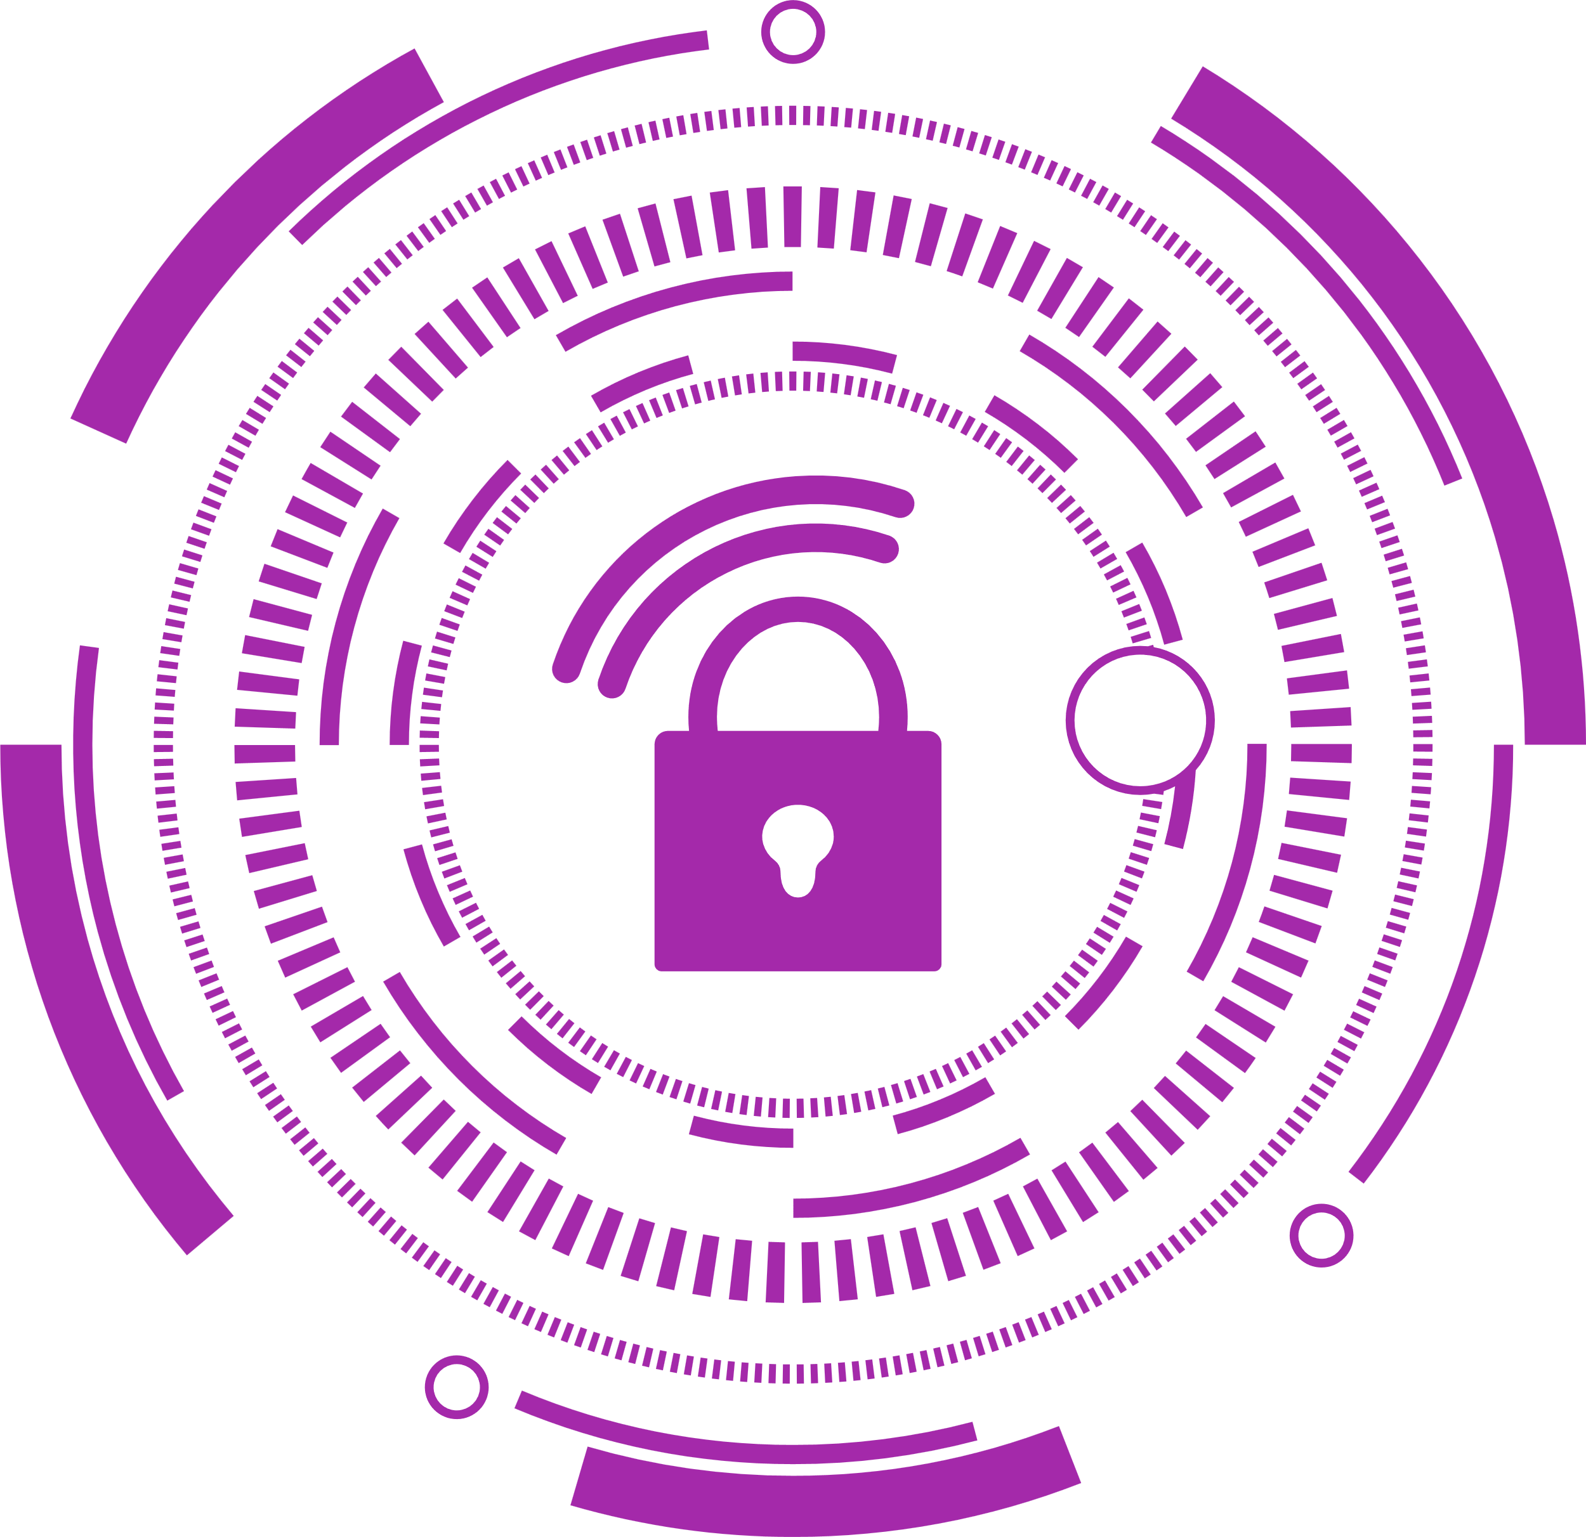
THE
AVENGERS
FINAL
RECOMMENDATIONS
FOR RANSOMEARE:
Simulated Attacks: Monthly phishing tests to measure employee readiness.
AI Email Filtering: Tools like Abnormal Security to catch lookalike domains.
FOR PHISHING:
Network Segmentation: Pre-defined VLAN shutdown procedures for outbreaks.
Backup Airgap: Ensure backups are immutable and offline.

Slide 15
THE
AVENGERS
THANK
YOU

